Slide 1

StreamForge: Data Pipeline Orchestration Platform
Visual Workflow Automation & AI-Assisted Data Transformation
Presented By: Abhinav R Nair
Guide : Divya R
Date: 12th jan 2026

Slide 2




StreamForge: Bridging the Gap
StreamForge is a cutting-edge, centralized digital platform meticulously designed to simplify and accelerate data workflow design, enable real-time pipeline execution, and facilitate AI-assisted data transformation.
Streamline Data Workflows
Real-time Execution
Intuitive design and management of complex data processes.
Monitor and control pipelines with immediate feedback.
AI-Assisted Transformation
Leverage AI for intelligent data manipulation and optimization.
Our core innovation integrates a drag-and-drop Visual Pipeline Builder with Google Gemini AI for intelligent debugging and real-time execution monitoring, empowering engineers and data scientists alike.

Slide 3

The Pain Points of Current Data Orchestration
Traditional data processing workflows are often plagued by inefficiencies and a steep learning curve, hindering productivity and innovation.
Manual Coding & ETL Challenges
Extensive, error-prone Python or SQL scripts are required for ETL processes, leading to significant development time and maintenance overhead.
Fragmented Tooling
Engineers constantly switch between various tools—IDEs, database clients, and separate visualization dashboards—creating a disjointed workflow and reducing efficiency.
High Technical Barrier
Building robust data pipelines demands deep programming knowledge, making advanced data manipulation inaccessible to many business stakeholders and junior data professionals.
Lack of Collaboration & Version Control
Dispersed local scripts and files complicate team collaboration, version management, and knowledge sharing, leading to inconsistencies and lost effort.

Slide 4

StreamForge: Our Innovative Solution
StreamForge introduces a paradigm shift in data pipeline management, offering intuitive visual tools, AI-powered assistance, and real-time insights.
Visual Orchestration
AI Chat Assistant
Design complex workflows with a powerful drag-and-drop interface, leveraging React Flow to eliminate manual boilerplate code and accelerate development.
A context-aware chatbot, powered by Google Gemini, provides intelligent debugging, optimization suggestions, and instant contextual help, enhancing productivity.
Real-Time Execution
Collaborative Workspace
Utilizing Socket.IO (WebSockets), the system delivers live status updates, performance metrics, and detailed execution logs for complete transparency.
A robust role-based sharing system (Viewer/Editor) enables seamless team collaboration, allowing collective management and monitoring of data pipelines.

Slide 5




StreamForge Architectural Modules
StreamForge is built upon a modular architecture, ensuring robustness, scalability, and efficient integration of diverse functionalities.
Frontend Module
AI Integration
Framework: React (Vite) for a fast, responsive UI.
Service: Google Gemini (Generative AI) for advanced intelligence.
Components: Interactive Dashboard, intuitive Pipeline Builder (React Flow),
Data Preview Panel, and comprehensive Admin Dashboard.
Function: Processes user queries and provides precise debugging
insights via chatbot_context.py, acting as an intelligent co-pilot.
Backend Engine
Database Module
Framework: Python Flask server handling all API requests.
Storage: SQLite database managed efficiently via SQLAlchemy ORM.
Processing: Leverages Pandas for advanced data manipulation
(filtering, sorting, joining) and Matplotlib for generating static charts.
Data: Securely stores user profiles, pipeline structures (JSON),
execution logs, and processed file metadata.

Slide 6




Feasibility Study: The Pillars of StreamForge Success
Our comprehensive analysis confirms StreamForge's viability across technical, economic, and operational dimensions.
Technical Feasibility
Economic Feasibility
Operational Feasibility
Built on robust, battle-tested open-source technologies (Python, React, SQLite).
Minimizes licensing costs by utilizing open-source libraries (Pandas, React Flow).
User-friendly visual interface significantly lowers the learning curve and reduces training time.
Modular architecture ensures stability, easy updates, and rapid development cycles.
Scalable design allows cost-effective deployment on standard cloud infrastructure.
Automated scheduling (Cron/Interval) dramatically reduces the need for manual intervention, freeing up valuable engineering resources.

Slide 7
User Table
User
Attribute
Description
id
Unique identifier for the user
username
User's login username
email
User's email address
is_admin
Boolean indicating if the user has administrator privileges
total_processed_bytes
Total data processed by the user in bytes

Slide 8
Pipeline Table
Pipeline
Attribute
Description
id
Unique identifier for the pipeline
name
Name of the workflow pipeline
structure (JSON)
JSON representation of the pipeline's workflow configuration
status
Current operational status of the pipeline
schedule
Defines the execution schedule for the pipeline

Slide 9
PipelineRun Table
Attribute
Description
id
Unique identifier for a specific pipeline execution instance
status (Success/Fail)
Outcome of the pipeline run
start_time
Timestamp when the pipeline run began
end_time
Timestamp when the pipeline run finished
logs
Detailed execution logs for the run

Slide 10
DataSource Table
Attribute
Description
id
Unique identifier for the data source
filename
Name of the uploaded raw data file
filepath
Storage path for the data file
file_size
Size of the data file in bytes

Slide 11
SharedPipeline Table
Attribute
Description
pipeline_id
Foreign key referencing the shared pipeline
user_id
Foreign key referencing the user with access
role (viewer/editor)
Access permission level (e.g., viewer, editor)

Slide 12
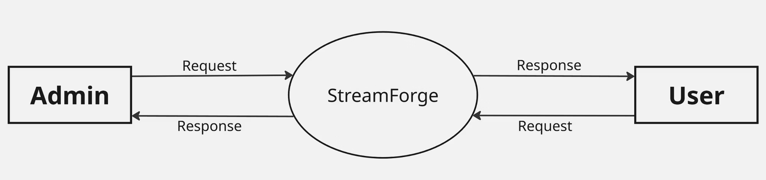
StreamForge Level 0 DFD
Level 0 Data Flow Diagram

Slide 13
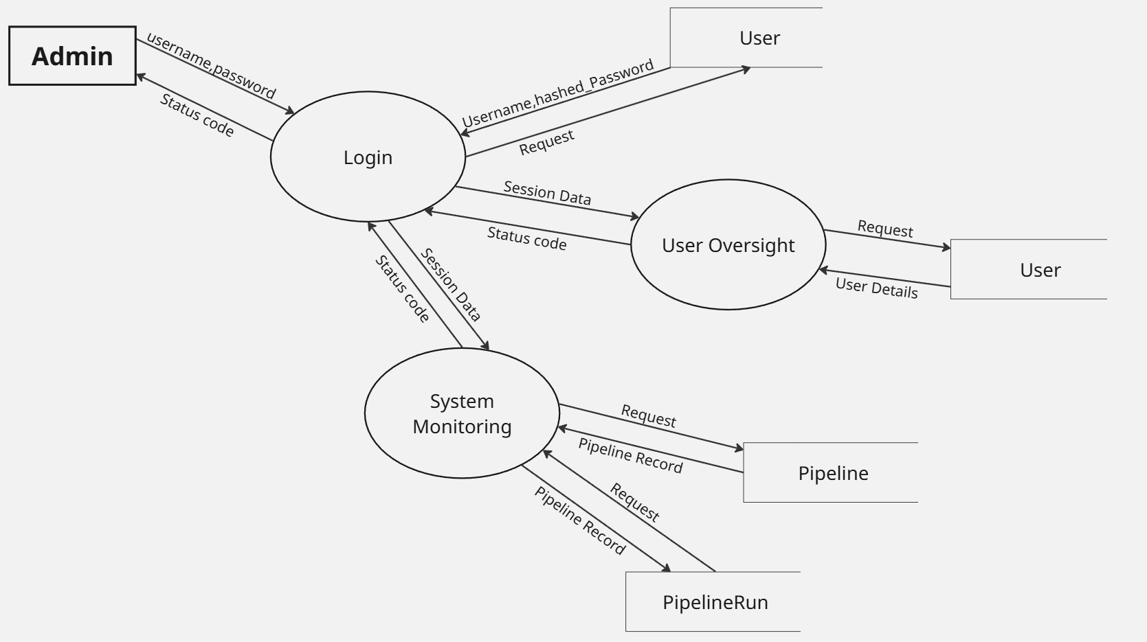
StreamForge Level 1 DFD: Admin Flow
Admin Flow

Slide 14
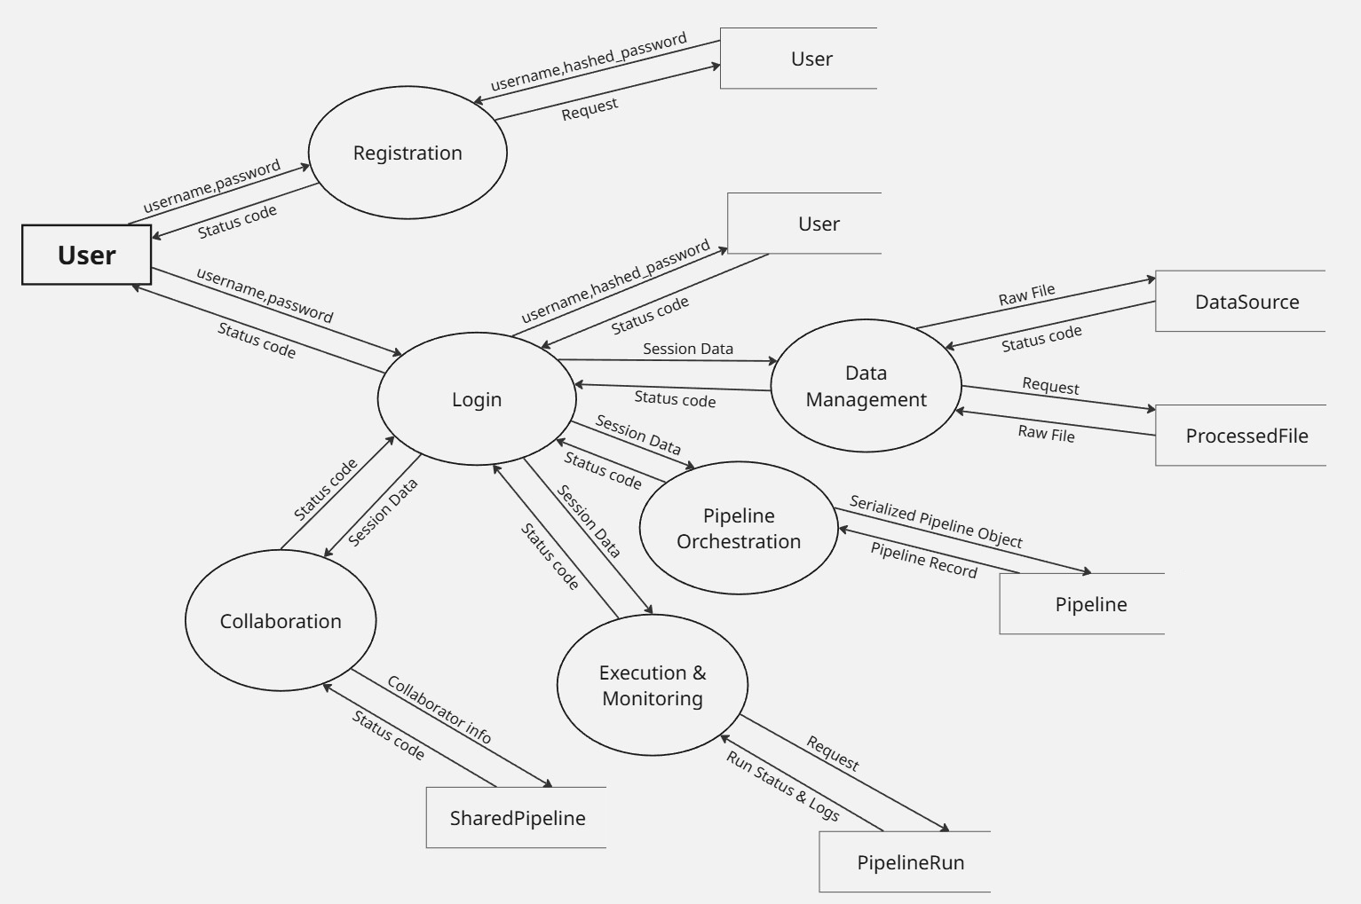
StreamForge Level 1 DFD: User Flow
User Flow

Slide 15
Thank You

